Slide 1
Women in leadership, leadership styles and managing diverse teams of people

Slide 2
What narratives do we hold about leadership?

Slide 3
Forbes.com - Female Leadership: Overcoming Stereotypes About Choosing The Best Leader
When people are asked about the stereotypical traits of leaders, they tend to talk about self-confidence, assertiveness, taking charge, solving problems, inspiring others, risk-taking and action-orientation — agentic qualities that are similar to the masculine stereotype. If the stereotypical leadership traits are those that are inherently associated with men, it’s not surprising that there can be prejudice about who is selected as leaders. Tomas Chamorro-Premuzic, in a Harvard Business Review article asks, “why so many incompetent men become leaders?” Perhaps the real answer is because we over-rely on shortcuts and stereotypes.
All of this is problematic because instead of asking what needs to be achieved in a leadership role, and from there identifying the best personal qualities for the leadership position, we unconsciously trend toward our prejudicial and biased views of leadership and who fits that picture.
https://www.forbes.com/sites/forbescoachescouncil/2021/01/26/female-leadership-overcoming-stereotypes-about-choosing-the-best-leader/?sh=2d4ca65a1ccb

Slide 4
An analysis performed on 1500 large US-based companies shows that there are less women in the leadership of these companies than men named John (2015, Ernst & Young)

Slide 5
What do we find out when we collect performance data?

Slide 6
Harvard Business Review, 2016
McKinsey study (2015), 366 companies:
The companies with racial and ethnic diversity at management level have 35% more profit than the rest of the companies in the same industry
The companies with gender diversity at management level have 15% more profit than the rest of the companies in the same industry
Credit Suisse study (2012), 2.400 companies:
The companies with at least one woman at the highest decisional levels record significantly more profit and more growth (26%)
HR study (2016), 20.000 companies from 91 countries:
The companies with most women in decision-making positions are the most profitable

Slide 7
Diverse teams = more radical innovation
Spanish study
Research and development departments,
4.277 de companies
A good gender balance leads to a dynamic that is positively connected to radical innovation when the task has a high level of novelty.

Slide 8
Diverse teams are intelligent and performant teams when they are well managed.
A higher focus on facts and a higher level of fact-reexamination.
Less decisions made from a place of bias, stereotype and perception.
A better capacity to identify key information, in order to not perpetuate subjective decisions, that can be inferiour decisions, exposed to errors.
The difference diminishes the levels of implicit accord, so the facts are better analysed and processed and the information is better used!

Slide 9
Diverse teams are more productive when they come to their optimal level of functioning.

Slide 10
2019 study: in the 360° evaluation, women are better evaluated than men with regard to leadership qualities (https://hbr.org/2019/06/research-women-score-higher-than-men-in-most-leadership-skills)
Capability | Women’s percentile | Men’s percentile
Takes initiative | 55.6 | 48.2
Resilience | 54.7 | 49.3
Practices self-development | 54.8 | 49.6
Drives for results | 53.9 | 48.8
Displays high integrity and honesty | 54.0 | 49.1
Develops others | 54.1 | 49.8
Inspires and motivates others | 53.9 | 49.7
Bold leadership | 53.2 | 49.8
Builds relationships | 53.2 | 49.9
Champions change | 53.1 | 49.8
Establishes stretch goals | 52.6 | 49.7
Collaboration and teamwork | 52.6 | 50.2
Connects to the outside world | 51.6 | 50.3
Communicates powerfully and prolifically | 51.8 | 50.7
Solves problems and analyzes issues | 51.5 | 50.4
Leadership speed | 51.5 | 50.5
Innovates | 51.4 | 51
Technical or professional expertise | 50.1 | 51.1
Develops strategic perspective | 50.1 | 51.4
Note: The t-values of all data are statistically significant.
Source: Zenger Folkman 2019 |  | © HBR

Slide 11
Perception and auto-perception
Stereotypes about women and the roles of women are difficult to change.
Women evaluate themselves in a harsher manner than they are externally evaluated.
Some women perceive themselves as less competent than they really are, while some men see themselves more competent than they really are.
Women have to also pass their internal barriers, that are socially constructed and integrated.
Women tend to attribute success to external factors, while men attribute success to internal factors.
The authority transference is not always fully made.
The leadership qualities have a higher ambivalent charge when they are practiced by women (ex: ambition, control, decision, assertiveness).

Slide 12
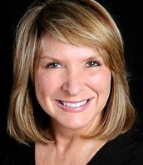
Heidi vs. Howard
Have you heard of the Heidi/Howard experiment? Heidi Roizen is a successful Silicon Valley venture capitalist who became the subject of a study at Columbia Business School.
Professor Frank Flynn presented half of his class with an original case study about Heidi Roizen. The second half of his class received an altered case study in which Heidi’s name was changed to “Howard”.
The students rated Howard and Heidi as equally competent, but they found Howard more likeable than Heidi. Specifically, the students who received Howard’s case study found him to be a smart and like-able leader, while the ones who received Heidi’s case study considered her to be too aggressive.
https://www.youtube.com/watch?v=3XG4MZFcYnE
https://toolbox.humandeluxe.com/heidi-vs-howard#:~:text=The%20students%20rated%20Howard%20and,her%20to%20be%20too%20aggressive

Slide 13
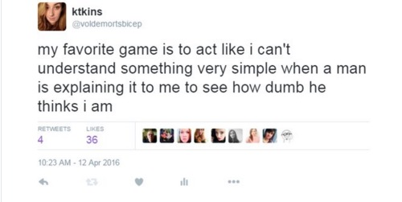
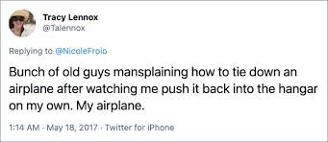
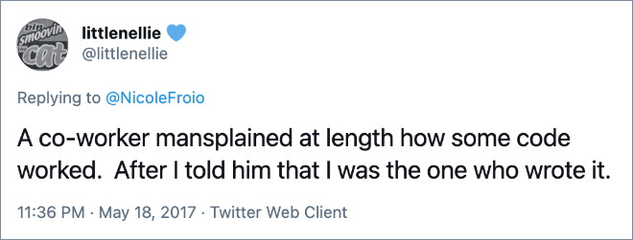

Slide 14
How do we meet and respond to stereotypes in real-life situations?

Slide 15
#distractinglysexy
”Let me tell you about my trouble with girls. Three things happen when they are in the lab: You fall in love with them, they fall in love with you, and when you criticize them they cry”.
(Tim Hunt, Nobel Prize Winner)

Slide 17
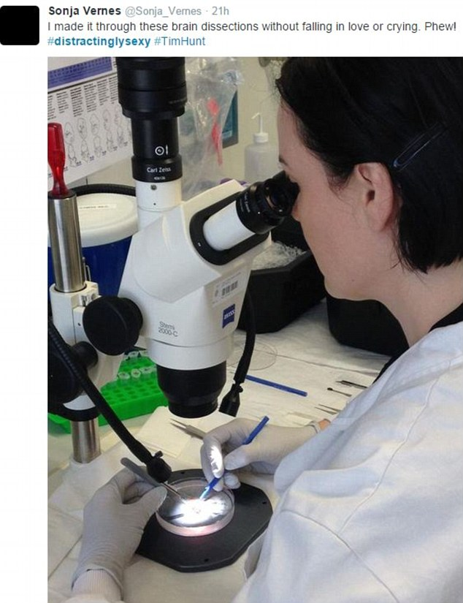
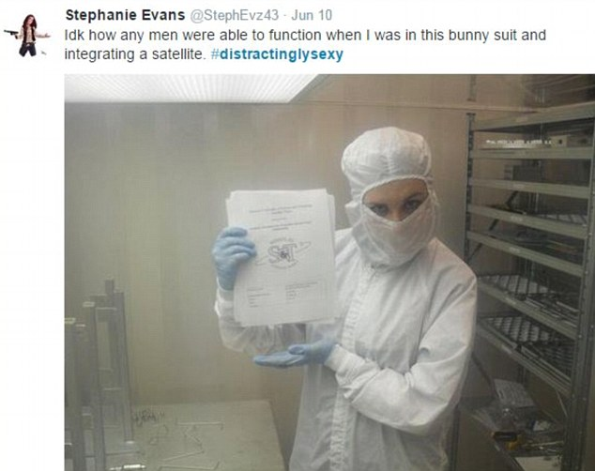

Slide 19
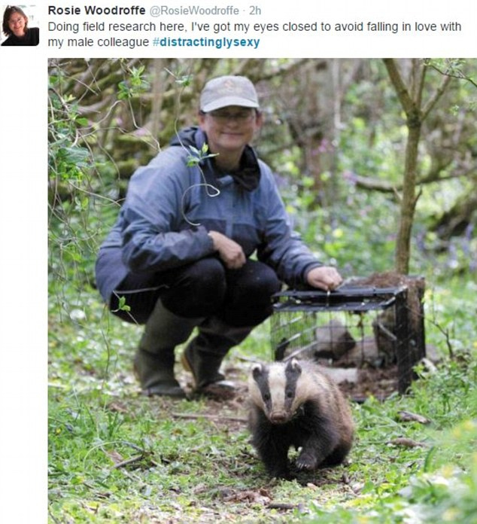
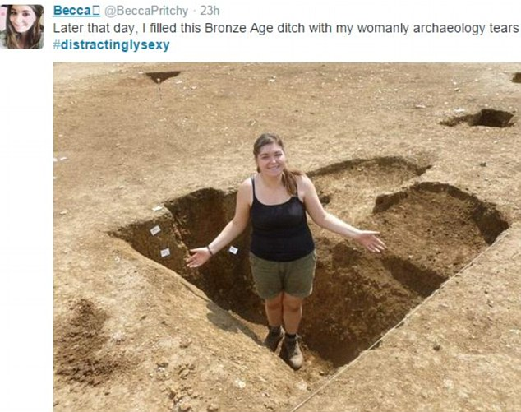

Slide 20
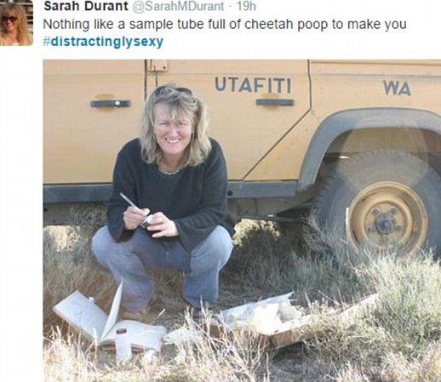
#distractinglysexy

Slide 21
A few aspects to keep in mind...
Education concerning gender stereotyping, gender roles and gender equality would be the most beneficial if it started early.
It would allow more persons, both women and men, to develop their skills to the highest of their potential; it would also allow them to access different types of experiences that would support their development as a whole.
Both women and men can benefit from a business environment that is less impacted by prejudice, stereotyping and bias.
Diverse teams mean added value and performance and it creates higher growth and development opportunities.

Slide 22
What leadership profile you think you display the most?

Slide 23
Anna
Imposes very high standards
Displays high levels of control
Intervines in solving tasks, micromanages the work of people
Needs to feel needed
Likes to be heard and seen
Appreciates structure and clarity, as well as respecting deadlines
Makes decisions quickly
Very interested in the quality of work and in career development

Slide 24
Diana
Charismatic and intelligent
Supports the emotional needs of the team members
Good knowledge of the personalities and personal contexts of all team members
Very invested in team coherence
Very good manager of the stress the team may be exposed to
Interested in created a very harmonious work environment
Values permanent positive feedback
People are her main concern
Strong values and professional ethics

Slide 25
Introverted and shy
Desires to lead by her own example
Offers autonomy to the persons she works with
Wants to make decisions by democratically consulting her team
Needs constant validation from her team
Values transparency in information sharing
Holds up to her mistakes
Listens to the needs and perspectives of her team
Emma

Slide 26
Claudia
Has a high level of trust in her team and intervenes very little in their work, allowing each team member the space to decide for their job as they see fit
Allows all employees to use their own creativity and resources to meet the organizational objectives
Provides a context in which each team member can take responsibility for their own work
Does not build and does not value a strict structure
Creates a relaxed work environment, appropriate for creative and independent workers

Slide 27
Adele
Flexible and adaptable
Loves to ask questions and to listen
Provides feedback on strenghts and vulnerabilities
Promptly answers to the team needs
Adapts to individual needs and supports growth
Provides and requires trust
Considers her main role is to support people to discover and make best use of their potential
Supports and takes responsibility for the career objectives of each team member

Slide 28
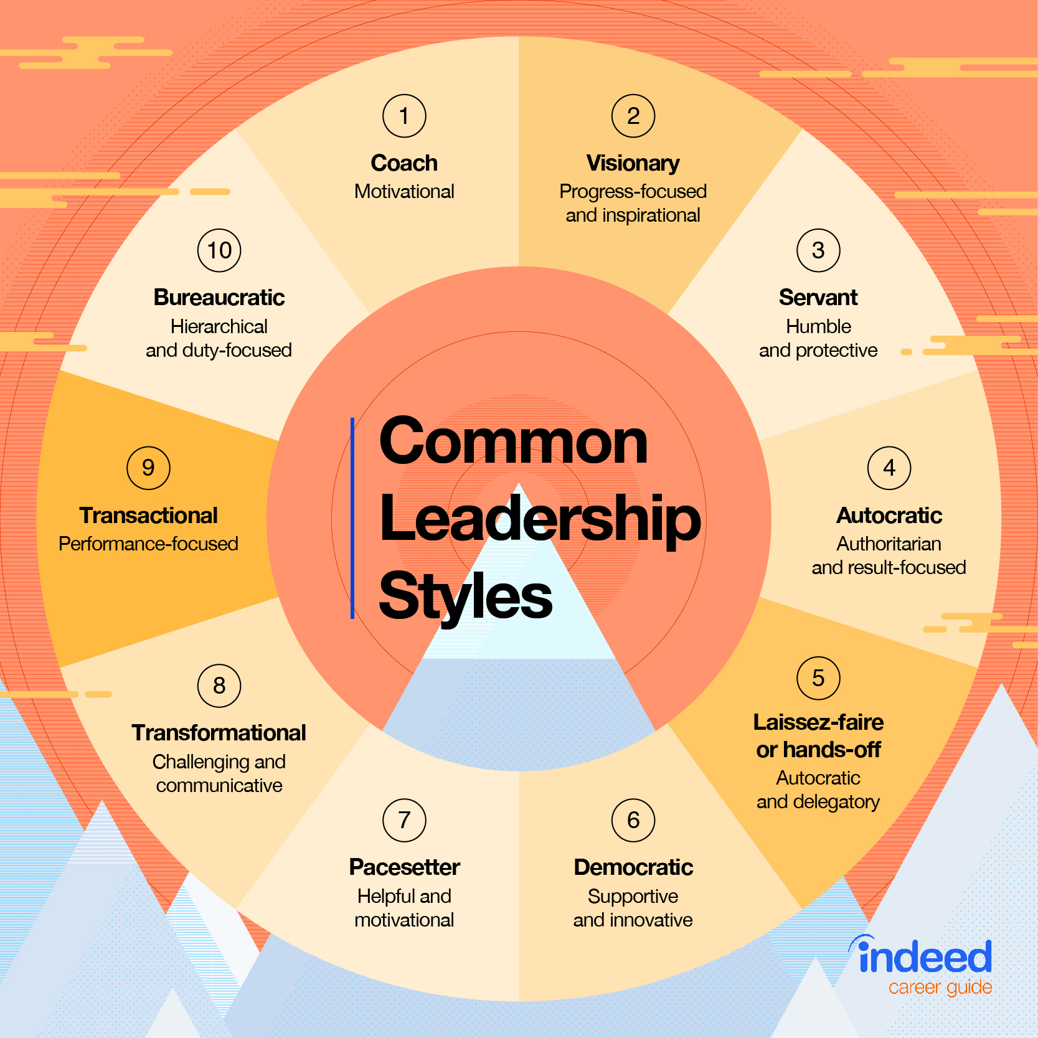
Common leadership styles

Slide 29
From your preffered leadership position, how would you manage the following cases?

Slide 30
Lucas is very connected with his colleagues and enjoys being part of his team. You ask him to work on a very important report and he confirms that the deadlines are reasonable. One day after the deadline, seeing that he did not send anything yet, you inquire about the report. Lucas tells you that he did not finish it, as he could not collect all the data from his colleagues. You feel very frustrated, as this situation will create a lot of unpleasant situations for you as well. How do you start a conversation with Lucas about what is going on? How do you manage this situation?
Lisa is an amazing employee. However, her performance had been suffering lately. She seems to be dettached and chaotic. Her results are not as good and she started to also behave out of character: she is late for meetings, she missed two deadlines, she started a conflict with another colleagues. How do you manage this situation? How do you better understand Lisas change and support her through it? How do you start a converstation with her about what is going on?

Slide 31
Jim had been with your company for a very long time. He is very well connected to all of his colleagues and usually is the first one to access and spread information, both formally and informally. When you hire a new colleague on a job similar to his, you overhear him saying to his colleagues that you only hired that man because he is handsome and you want some ”eye candy” in the office. He also mentioned another hire you made 6 months ago as being your niece, which is not true. How do you manage this situation?
Andrea becomes really irritable when working under pressure. He is always able to perform at her job, even under stressful conditions, but the atmosphere she creates in the office is really difficult to handle. Colleagues are complaining about her behaviour actually creating a hostile working environment for them. How do you manage this situation? How do you start the conversation with Andrea?

Slide 32
Thank you!

